Slide 1
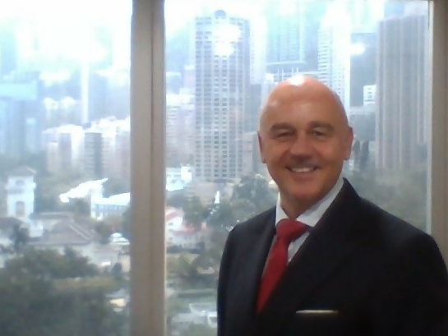
An Introduction To
Syndication-Investing In Australian Real Estate
The NEW way to buy in Australia, investing with NO stamp duty, NO foreign investor fees, and NO capital gains tax.
MICHAEL BENTLEY

Slide 2
Current Challenges In Buying Direct Property Include:
01
Stamp duties
06
Taxes
02
07
Market uncertainty
Buyers taxes
03
Bank lending
08
Cash outlay
04
Waiting time
05
Valuations

Slide 3
Costs Of Buying
Melbourne
AU$600K,
foreign investor
Others
13K
Costs
Taxes
73K
Total Cash Needed
AU$266,000
Deposit
180K
44%
!
Property
COSTS
HK$1.5 million
SG$252K
US$184K
Loan
420K

Slide 4
Disclaimer
IMPORTANT NOTICE:
Any forecasts in this presentation are based upon Citylife’s opinion of the market at the date of the presentation and are subject to change without notice, dependent upon many factors.
Any prediction, projection or forecast is not necessarily indicative of the future or likely performance.
Investment involves risk.
The value of any investments and any income generated may go down as well as up and is not guaranteed.
Past performance is no indication of current or future performance. Any investment results, or examples set forth in this document are provided for illustrative purposes only and are not indicative of any future investment results or investments.
No representation is made that an investment will be profitable or will not incur losses.
Prospective investors should read the offering documents for the details and specific risk factors of any investment mentioned.

Slide 5
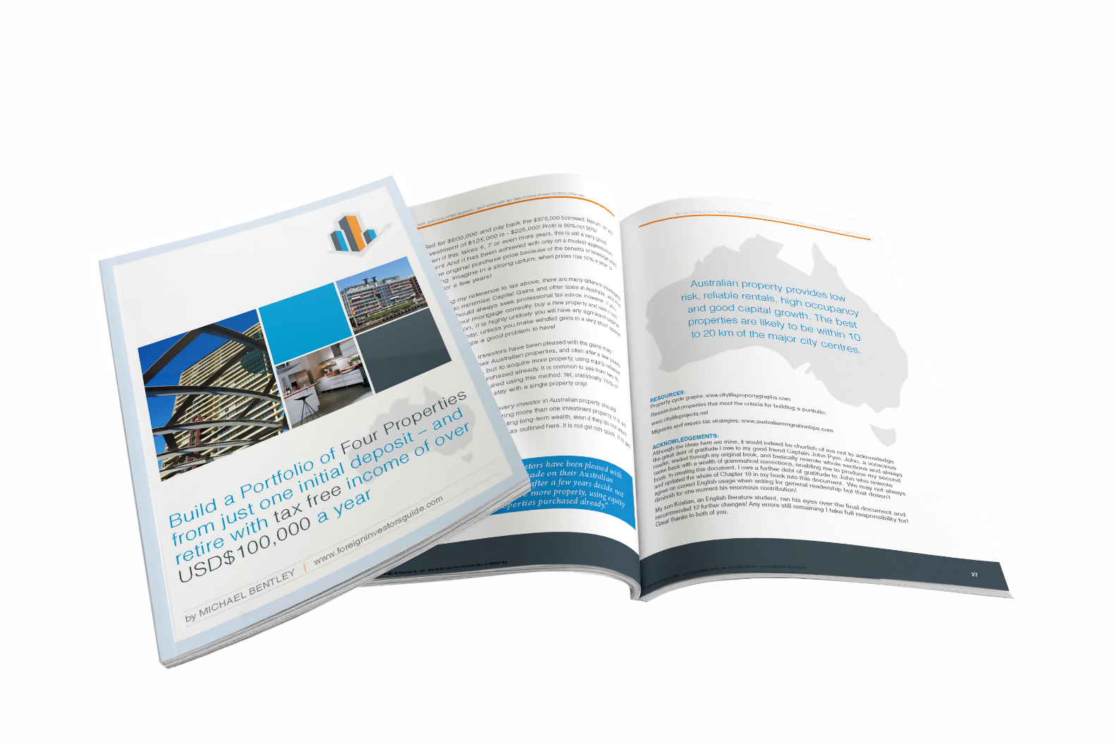
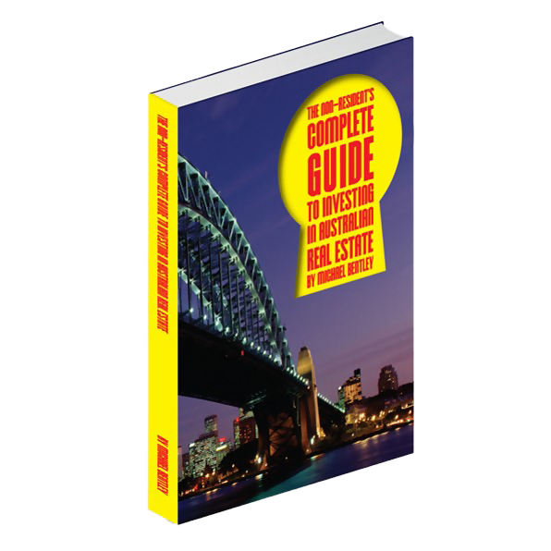
MICHAEL BENTLEY: AUTHOR OF:

Slide 6
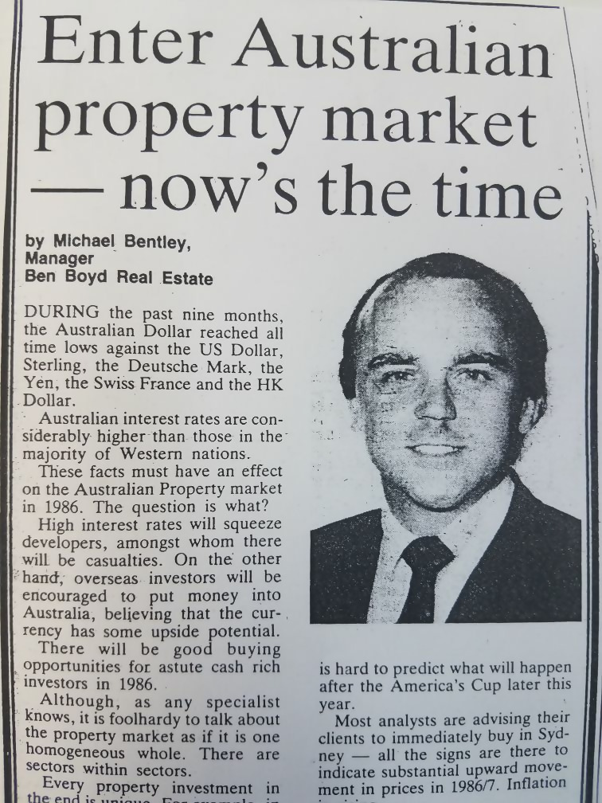
Michael Bentley
Citylife International Realty
Hong Kong
1986!
1998?
2008?
2018?

Slide 7
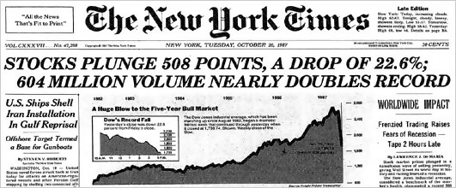
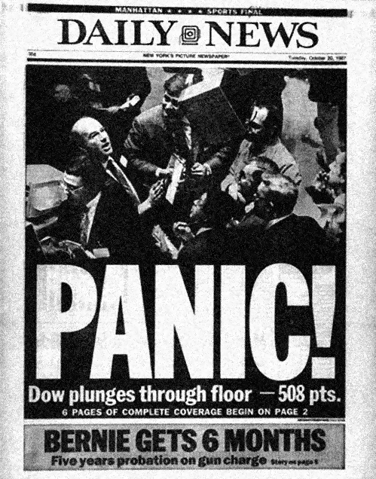

Slide 8
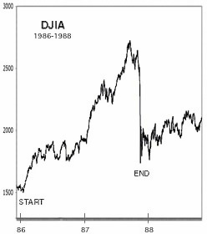

Slide 9
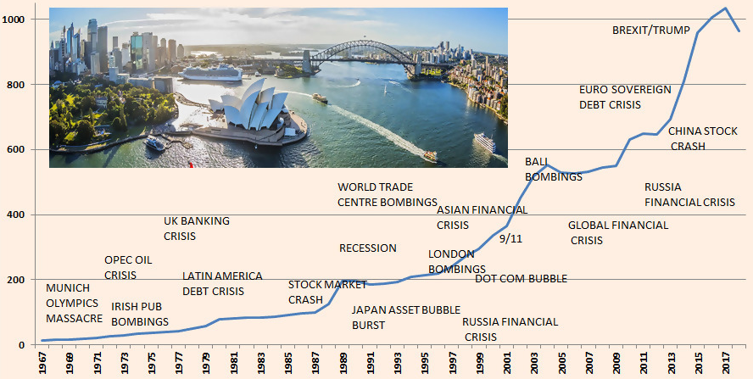
Sydney Residential Property Prices 1967 - 2018
Data Sources: Bis Shrapnel and SQM Research

Slide 10
Australia Population
Source: www.tradingeconomics.com | Australian Bureau of Statistics

Slide 11
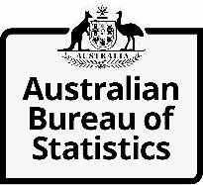
Australia's population:
37-49 million
by 2066 (Currently 25.4 Million)
20 million
new migrants coming!
STOP PRESS!

Slide 12
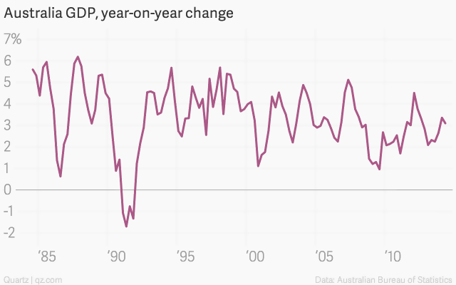
Australia Has Gone 27 Years Without a Recession
“Australia’s Political Shock Echoes From Ohio to London”
May 19, 2019

Slide 13
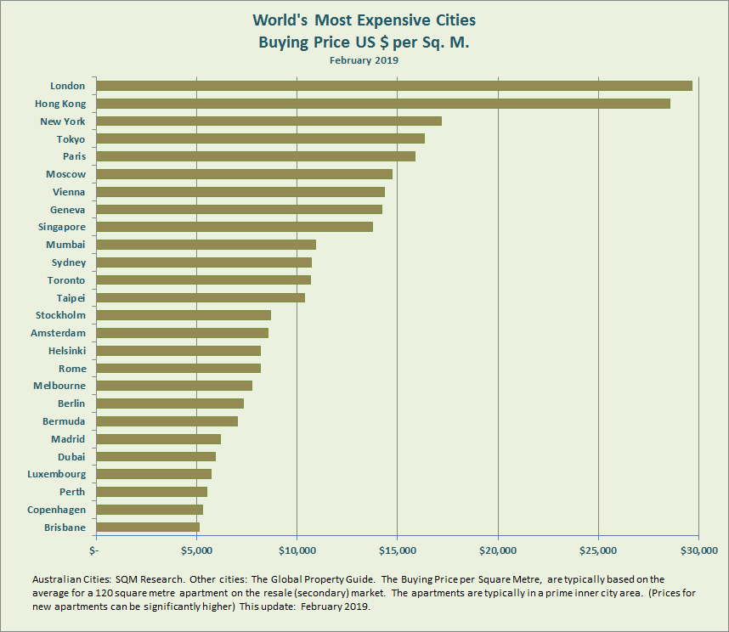
World’s Most Expensive Cities in US$ Per Square Meter

Slide 14
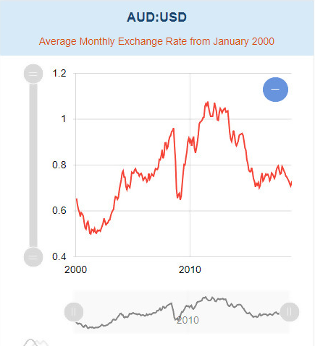

Slide 15
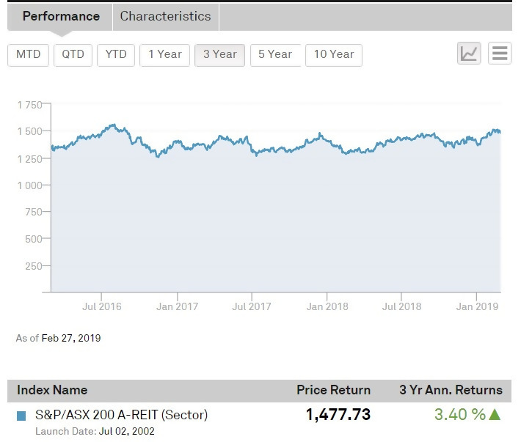
How To Benefit From This Situation?
“Real estate funds in private equity expect a 50 percent growth by 2023 to reach a market size of US$1.2 trillion.”
03
02
01
Shares
In A Property Fund/Reit
Indirect Purchase Through Property Syndication
Direct Residential Purchase

Slide 16
The Solution:
Syndication?
What Is A Property Syndicate?
is a process whereby groups of investors pool their funds to acquire larger assets or complete bigger projects than could be tackled individually.

Slide 17
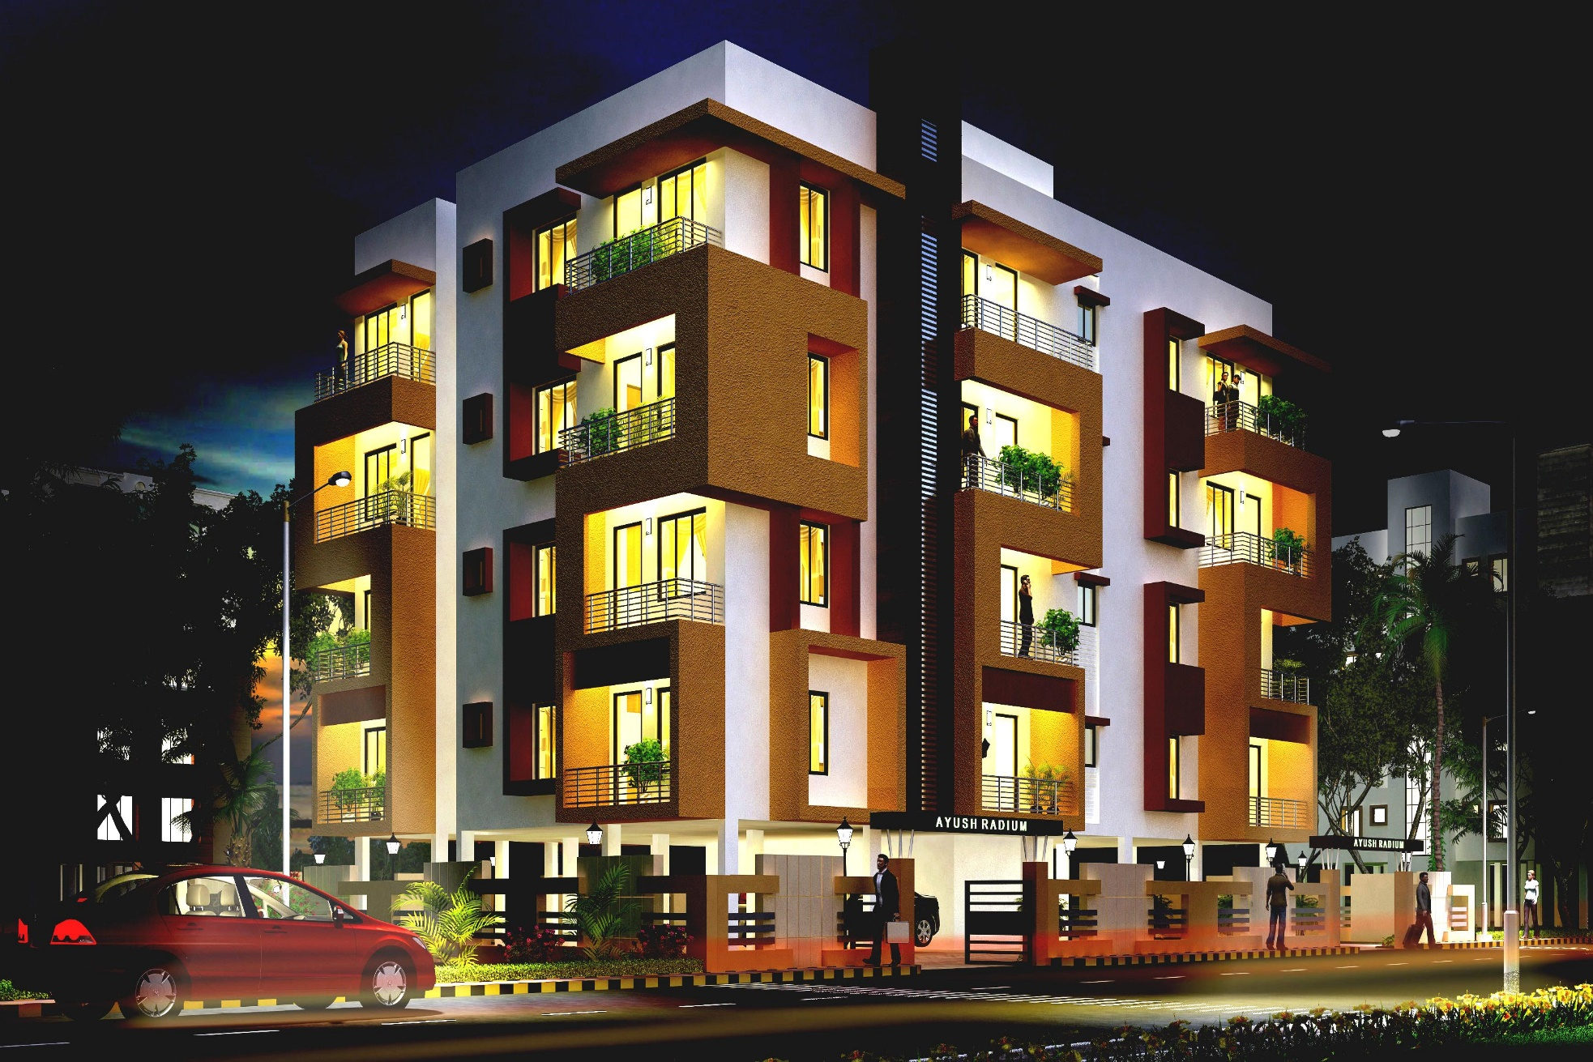

Slide 18
2 Years Research

Slide 19
Syndicate Options:
Australian Residential:
Australian Commercial:
approx.
2 years
investment
approx.
3-7 years
investment

Slide 20
Disadvantages of Syndication Investment
No actual ownership
No ability to create a portfolio
Investment is not liquid
No equity available
No bank lending available
Generally, most syndications do not have a long term “never sell” philosophy, meaning once a suitable profit has been made, the syndicate will sell and return investors funds plus profits
Not open to the public. Qualified investors only
Strong Demand

Slide 21
Investors May Benefit From:
Plus
NO Stamp Duty
NO Foreign Investor Taxes
NO Capital Gains Tax

Slide 22
Investors May Benefit From:
+
The syndicator is a specialist in real estate investing with years of experience.
Pooling resources allowing investing in larger properties.
Expert management.
Tax advantages can pass through to the investors.
A syndicate can make profits from rental income.
Freedom from management for the investors.
No Legal Fees.
No bank loans needed.
No tenants to deal with.
+

Slide 23
Investors May Benefit From:
+
No Body Corporate fees to pay by individual investors.
No Council and Water rates paid by individual investors.
No Sales Commission (unlike the normal disposal of properties)
Diversification of Investment Properties (across projects, states & locations)
No repairs.
No Government rates to pay.
No Land Tax
No Vacancy Tax
No Foreign Buyers Surcharge Tax

Slide 24
Residential V Commercial Syndicates
Residential:
Commercial:
Lower entry capital AU$100k (HK$560K)
Low taxes (10%)
Short term
Small projects
Target 12% returns
Higher entry capital AU$500K (HK$2.8M)
Higher taxes (15%-30%)
Longer term
Large projects
Target 8% (Track record 20% IRR plus)
Value-add opportunities

Slide 25
Summary:
An alternative
to direct investment
Management by experts
Lower costs, taxes, fees and less work/hassle
Potentially higher returns

Slide 26
Thank You
www.CitylifeSyndicates.com
Visit us at Stand B10 CITYLIFE:
AUSTRALIAN PROPERTY SYNDICATES
Mike Bentley
+852 9736 2218
mike@citylifeproperty.com
To get a FREE COPY of my TOP SELLING BOOK!

